Slide 1
Git Workflow
Module 5 - Version Control with GIT

Slide 2
Git’s 3-Tree Architecture
Working Directory: this is where we make changes to our code. The files in this directory are untracked. We can ask Git to ignore some files/ folders in this directory with a .gitignore file.
Staging Index: this contains the changes that will be committed to the repository. We add files into this staging index.
Repository: changes that have been committed and are given a SHA-1 hash value. The history of these changes are stored in the repository and we can revert back to these versions.
Working Directory
Staging Index
Repository

Slide 3
The general workflow of using Git is init/clone, make changes, add, commit, push
Create a new local repo with git init or clone an existing remote repo with git clone
Create/edit files for a feature in the directory. Make code changes as necessary.
Ask git to track the files by adding them to the staging index using git add
Use git status to see which files are untracked in the Working Directory and which are Staged but have been modified
Add the required files that form part of the change set to the Staging Index with git add
When satisfied with your progress, commit the files to the Repository with git commit passing in a commit message with –m “message text”
Git Workflow
Notes:
At this stage, do a demonstration of a basic edit/addition of a file and using git status, adding it to the staging area, committing and pushing to a remote repo

Slide 4
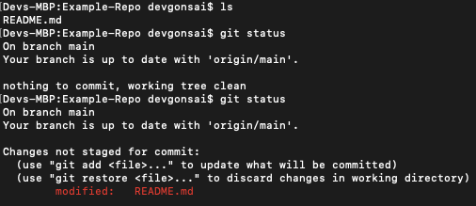
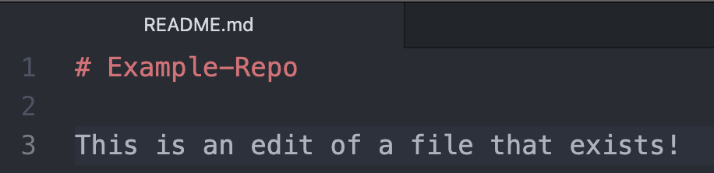
We’ve cloned a repository down that has a README.md file within it. Running an ls command shows this. We run git status to see the state of the working area – no changes yet!
An example workflow (1)
We make some changes to a file (the README in this example) and save it.
Running git status now shows that a file has been modified – reflective of what we’ve done in the file previously.

Slide 5
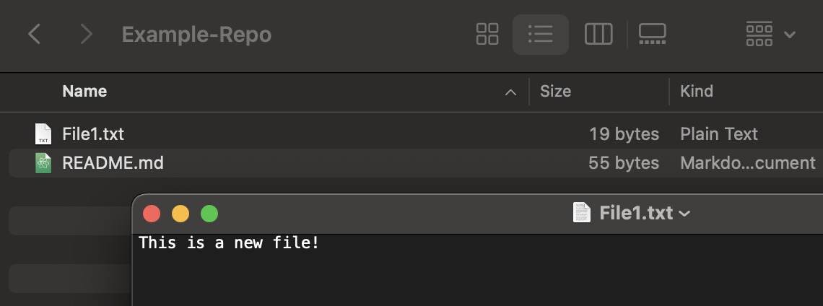
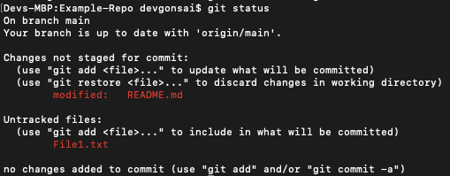
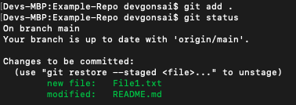
We’ve also added a new file into the directory called File1.txt
An example workflow (2)
Running git status shows that a file has been modified and another has been created (i.e. untracked)
We can now stage these files with the git add . (the period meaning all files)
These files are ready to push onto our GitHub repository.

Slide 6
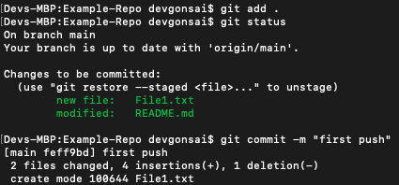
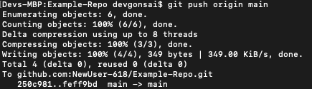
We run the git commit command with –m and a message in double quotes. This creates a new revision of the VCS with all files added previously
An example workflow (3)
We can then push our changes to our remote repository with the command git push. We add origin main as this is the branch we’re pushing to - more on this later.

Slide 7
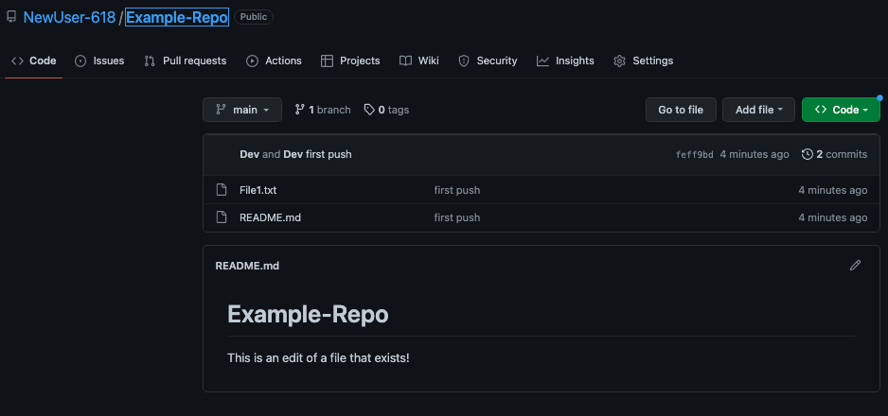
Back on GitHub, our changes have been made!!
An example workflow (4)

Slide 8
Exercise 2: Adding files
Create files
Stage the files
Push the changes to your remote repository
Add a new file, commit, push again

Slide 9
This basic git workflow can be improved.
We are currently making code changes on the default branch (main).
This is not ideal. Instead we should use a technique called branching that allows each new feature or bug fix to be worked on in isolation.
Basic Workflow

Slide 10
Example: Branching and Merging
Main
Branch
Dev 2 Branch
Dev 1 Branch
File1
File2
File3
File4
File1 with Dev1 changes
File merged with changes from Dev1 and Dev2
File5
Dev 1
File3
File4
File1 modified
by Dev 1
Dev 2
File1 modified by Dev2
File 1 merged with changes from Dev1 and Dev2
File5
Branches allow members of the development team to work on different parts of a project without impacting the main branch. When the work is complete, a branch can be merged with the main branch.
Notes:
Commits on the parent branch are visible to all child branches at the point of branching
If a file is changed on a child branch, it will create a copy/delta on that branch
Branches are often created for new features and hotfixes
It is important to regularly merge code from different branches to prevent the code from diverging which will likely cause many merge conflicts when merged at a much later time
An example use case why a developer may need to work on the same file as another is a shared Menu on a web page. Many menu items need to be added for each new software feature so multiple developer will need to add menu items.

Slide 11
Branching allows each developer to work on new features in isolation by creating a version of the source code that only they are working on.
This new version is called a feature branch. It shares a common history with the main branch at the point the branch was created.
Once changes have been made and the feature implemented, the feature branch code is merged back into the main branch.
Git will automatically detect the differences between the feature branch and main branch and alert the developer if there are any conflicts.
Conflicts arise if changes are made to the same lines of code within the feature branch and the main branch after the feature branch has been created.
Why Use Branches?

Slide 12
You can see all the current branches in your repository using:
Creating Branches
git branch
To create a new branch, the command is:
# git branch [NEW_BRANCH_NAME]
git branch develop
This will create a new branch from whichever branch you are currently on (so this new branch will branch from main if you run the command whilst on that branch).
If you want to work on a new branch straight away, you can create a branch and checkout to it at the same time:
# git checkout -b [NEW_BRANCH_NAME]
git checkout -b develop

Slide 13
Deleting Branches
When you have finished working on your branch, and your code has been merged to main, it is good practice to delete the branch:
# git branch -d [BRANCH_NAME]
git branch -d feature-123
You will also need to do this on your Git Service, (such as GitHub). This is usually done when closing a Pull Request.
If you are not closing a Pull Request and find yourself needing to delete a branch, you can use the following command to delete a branch on your remote repository (e.g., on GitHub):
# git push --delete origin [BRANCH_NAME]
git push --delete origin feature-123

Slide 14
Exercise 3: Branching
Create a new branch
Create a file on the new branch
Add, commit, push
Inspect GitHub

Slide 15
End of section

